Slide 1


HULA: Scalable Load Balancing Using Programmable Data Planes
Naga Katta¹
Mukesh Hira², Changhoon Kim³, Anirudh Sivaraman⁴,
Jennifer Rexford¹
1.Princeton 2.VMware 3.Barefoot Networks 4.MIT

Slide 2
Datacenter Load Balancing
Multiple network paths
High bisection bandwidth
Volatile traffic
Multiple tenants

Slide 3
A Good Load Balancer
Multiple network paths
Track path performance
Choose best path
High bisection bandwidth
Volatile traffic
Multiple tenants

Slide 4
A Good Load Balancer
Multiple network paths
Track path performance
Choose best path
High bisection bandwidth
Fine grained load balancing
Volatile traffic
Multiple tenants

Slide 5
A Good Load Balancer
Multiple network paths
Track path performance
Choose best path
High bisection bandwidth
Fine grained load balancing
Volatile traffic
In-dataplane
Multiple tenants

Slide 6
A Good Load Balancer
Multiple network paths
Track path performance
Choose best path
High bisection bandwidth
Fine grained load balancing
Volatile traffic
In-dataplane
Multiple tenants
In-network

Slide 7
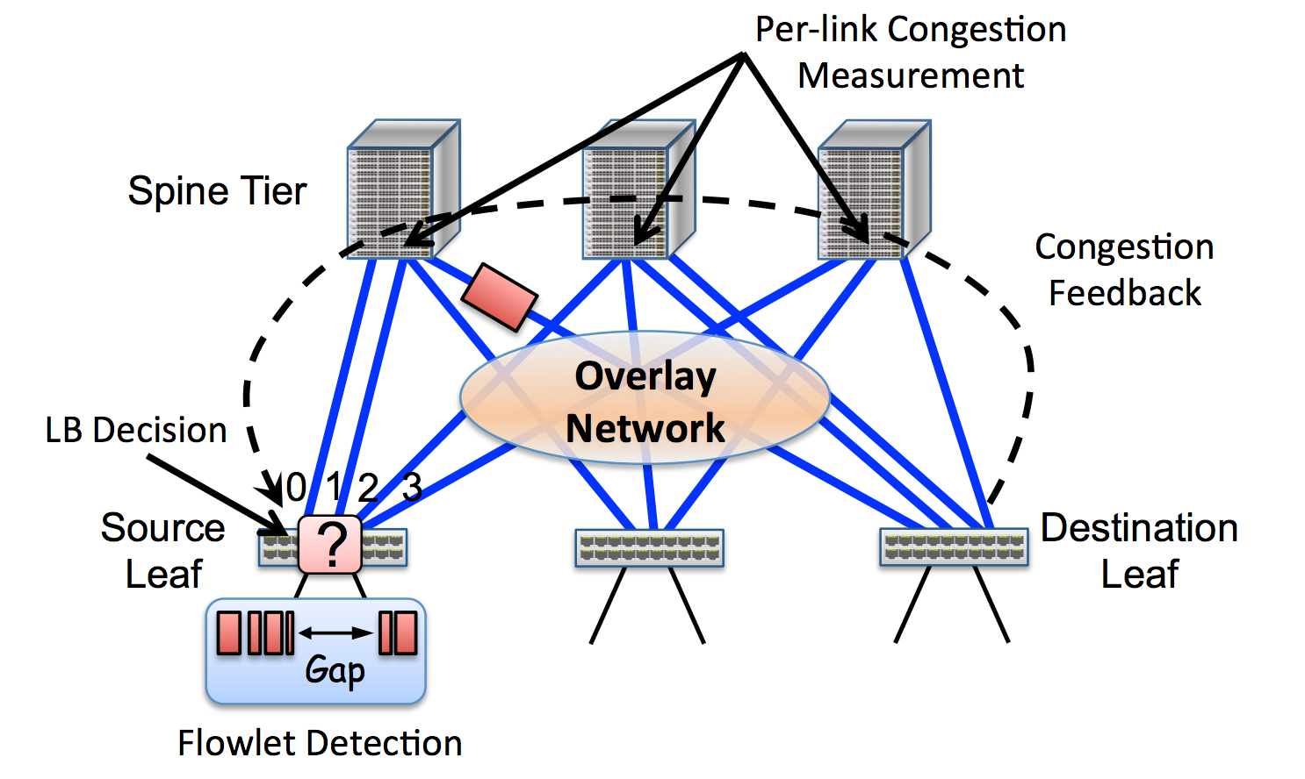
CONGA (SIGCOMM’14)

Slide 8
Datapath LB: Challenges
Tracks all paths

Slide 9
Datapath LB: Challenges
Large FIBs
Tracks all paths

Slide 10
Datapath LB: Challenges
Large FIBs
Custom ASIC
Tracks all paths

Slide 11
Programmable Commodity Switches
Vendor agnostic
Uniform programming interface (P4)
Today’s trend -> cheaper
Reconfigurable in the field
Adapt or add dataplane functionality
Examples
RMT, Intel Flexpipe, Cavium Xpliant, etc.

Slide 12
Programmable Switches - Capabilities
More than OF 1.X
P4 Program
Compile
Memory
Memory
Memory
Memory
M | A
m1 | a1
M | A
m1 | a1
M | A
m1 | a1
M | A
m1 | a1
Ingress Parser
Queue Buffer
Egress Deparser

Slide 13
Programmable Switches - Capabilities
More than OF 1.X
P4 Program
Programmable Parsing
Compile
Memory
Memory
Memory
Memory
M | A
m1 | a1
M | A
m1 | a1
M | A
m1 | a1
M | A
m1 | a1
Ingress Parser
Queue Buffer
Egress Deparser

Slide 14
Programmable Switches - Capabilities
More than OF 1.X
P4 Program
Programmable Parsing
Compile
Memory
Memory
Memory
Memory
M | A
m1 | a1
M | A
m1 | a1
M | A
m1 | a1
M | A
m1 | a1
Ingress Parser
Queue Buffer
Egress Deparser
Match-Action
Pipeline

Slide 15
Programmable Switches - Capabilities
More than OF 1.X
P4 Program
Programmable Parsing
Register Array
Compile
Memory
Memory
Memory
Memory
M | A
m1 | a1
M | A
m1 | a1
M | A
m1 | a1
M | A
m1 | a1
Ingress Parser
Queue Buffer
Egress Deparser
Match-Action
Pipeline

Slide 16
Programmable Switches - Capabilities
More than OF 1.X
P4 Program
Programmable Parsing
Stateful
Memory
Compile
Memory
Memory
Memory
Memory
M | A
m1 | a1
M | A
m1 | a1
M | A
m1 | a1
M | A
m1 | a1
Ingress Parser
Queue Buffer
Egress Deparser
Switch
Metadata
Match-Action
Pipeline

Slide 17
Hop-by-hop Utilization-aware Load-balancing Architecture
Distance-vector like propagation
Periodic probes carry path utilization
Each switch chooses best downstream path
Maintains only best next hop
Scales to large topologies
Programmable at line rate
Written in P4.

Slide 18
HULA: Scalable and Programmable
Objective | P4 feature
Probe propagation | Programmable parsing
Monitor path performance | Link state metadata
Choose best path, route flowlets | Stateful memory and comparison operators

Slide 19
Probes carry path utilization
Spines
Probe replicates
Aggregate
Probe originates
ToR
Notes:
Let’s dig a little deeper. In HULA, the probes originate at the ToRs (through the servers or the ToRs themselves) and then are replicated on multiple paths as they travel the network. We make sure that each switch replicates only the necessary set of probes to the others so that the probe overhead is minimal.

Slide 20
Probes carry path utilization
P4 primitives
New header format
Programmable Parsing
RW packet metadata
Spines
Probe replicates
Aggregate
Probe originates
ToR
Notes:
Let’s dig a little deeper. In HULA, the probes originate at the ToRs (through the servers or the ToRs themselves) and then are replicated on multiple paths as they travel the network. We make sure that each switch replicates only the necessary set of probes to the others so that the probe overhead is minimal.

Slide 21
Probes carry path utilization
ToR ID = 10 Max_util = 80%
S2
ToR ID = 10 Max_util = 60%
ToR 10
ToR 1
S1
S3
Probe
S4
ToR ID = 10 Max_util = 50%

Slide 22
Each switch identifies best downstream path
ToR ID = 10 Max_util = 50%
S2
ToR 10
ToR 1
S1
S3
Probe
Dst | Best hop | Path util
ToR 10 | S4 | 50%
ToR 1 | S2 | 10%
… | …
S4
Best hop table
Notes:
Then the switch takes the minimum from among the probe given utilization and stores it in the local routing table. The switch S1 then sends its view of the best path to the upstream switches. And the upstream switches process these probes and update their neighbours. This leads to a distance vector-style propagation of information about network utilization to all the switches. But at the same time, each switch only needs to keep track of the best next hop towards a destination.

Slide 23
Switches load balance flowlets
Flowlet table
Dest | Timestamp | Next hop
ToR 10 | 1 | S4
 | … | …
 | … | …
S2
ToR 10
ToR 1
Data
S1
S3
Dest | Best hop | Path util
ToR 10 | S4 | 50%
ToR 1 | S2 | 10%
… | …
S4
Best hop table
Notes:
The switches then route data packets in the opposite direction by spitting flows into smaller groups of packets called flowlets. Flowlets basically are subsequences of packets in a flow separated by a large enough inter-packet gap so that when different flowlets are sent on different paths, the destination does not see packet reordering with high probability.

Slide 24
Switches load balance flowlets
P4 primitives
RW access to stateful memory
Comparison/arithmetic operators
Flowlet table
Dest | Timestamp | Next hop
ToR 10 | 1 | S4
 | … | …
 | … | …
S2
ToR 10
ToR 1
Data
S1
S3
Dest | Best hop | Path util
ToR 10 | S4 | 50%
ToR 1 | S2 | 10%
… | …
S4
Best hop table
Notes:
The switches then route data packets in the opposite direction by spitting flows into smaller groups of packets called flowlets. Flowlets basically are subsequences of packets in a flow separated by a large enough inter-packet gap so that when different flowlets are sent on different paths, the destination does not see packet reordering with high probability.

Slide 25
Switches load balance flowlets
P4 code snippet
if(curr_time - flowlet_time[flow_hash] > THRESH) {
flowlet_hop[flow_hash] =best_hop[packet.dst_tor];
}
metadata.nxt_hop = flowlet_hop[flow_hash];
flowlet_time[flow_hash] = curr_time;
Flowlet table
Dest | Timestamp | Next hop
ToR 10 | 1 | S4
 | … | …
 | … | …
S2
ToR 10
ToR 1
Data
S1
S3
Dest | Best hop | Path util
ToR 10 | S4 | 50%
ToR 1 | S2 | 10%
… | …
S4
Best hop table
Notes:
The switches then route data packets in the opposite direction by spitting flows into smaller groups of packets called flowlets. Flowlets basically are subsequences of packets in a flow separated by a large enough inter-packet gap so that when different flowlets are sent on different paths, the destination does not see packet reordering with high probability.

Slide 26
Evaluated Topology
S1
S2
Link Failure
40Gbps
A1
A2
A3
A4
40Gbps
L1
L2
L3
L4
10Gbps
8 servers
per leaf

Slide 27
Evaluation Setup
NS2 packet-level simulator
RPC-based workload generator
Empirical flow size distributions
Websearch and Datamining
End-to-end metric
Average Flow Completion Time (FCT)

Slide 28
Compared with
ECMP
Flow level hashing at each switch
CONGA’
CONGA within each leaf-spine pod
ECMP on flowlets for traffic across pods¹
1. Based on communication with the authors

Slide 29
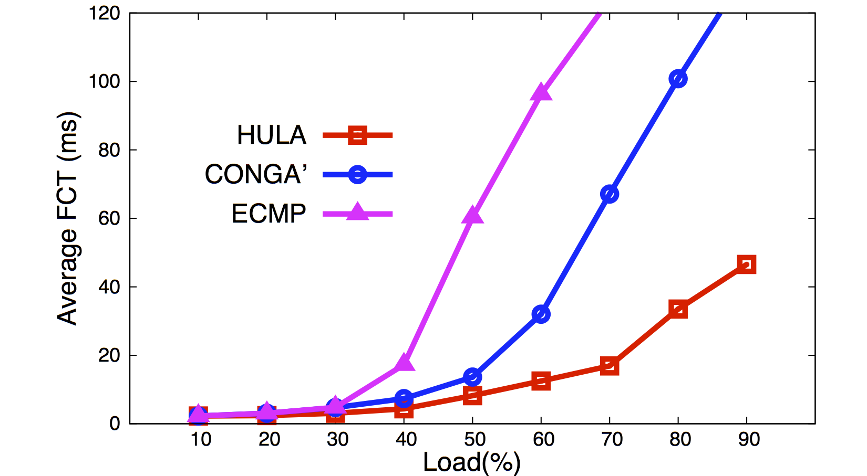
HULA handles high load much better

Slide 30
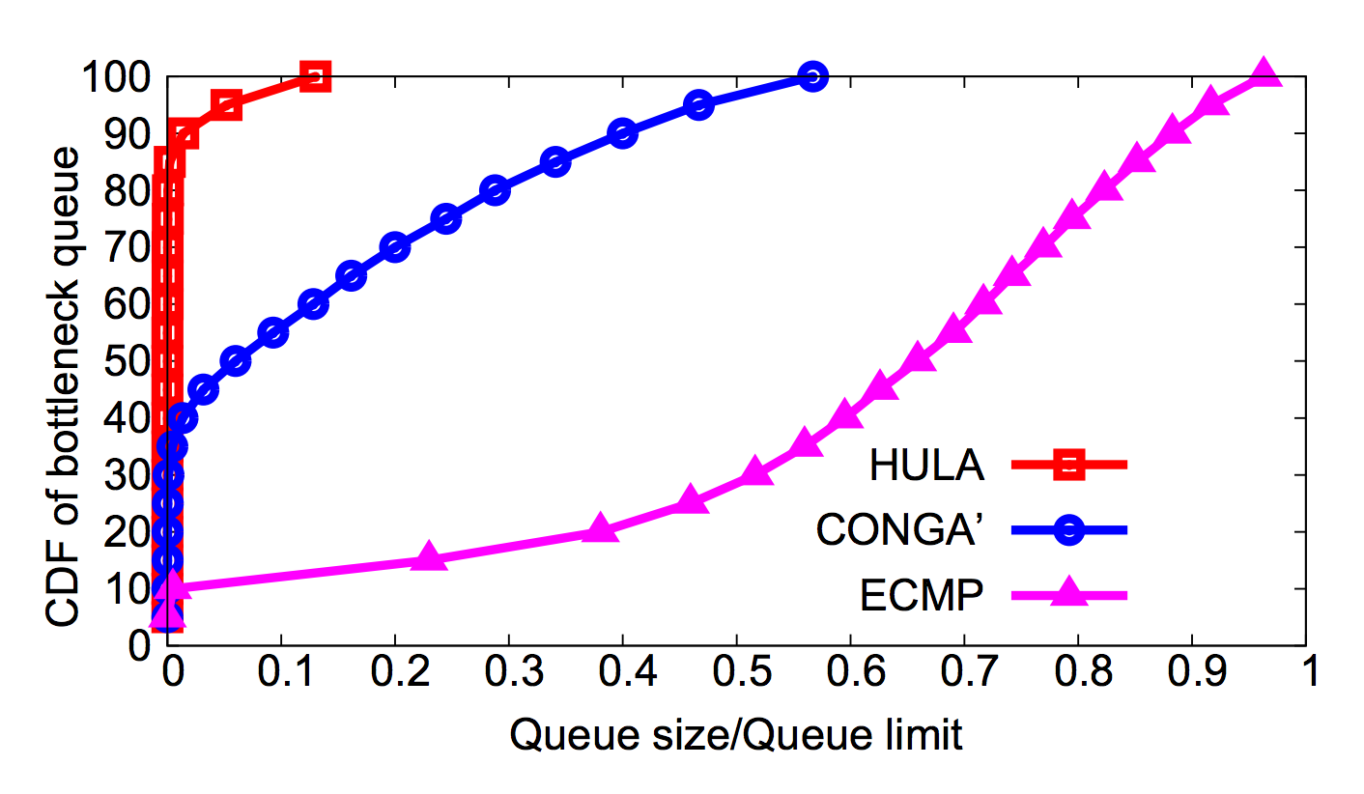
HULA keeps queue occupancy low

Slide 31
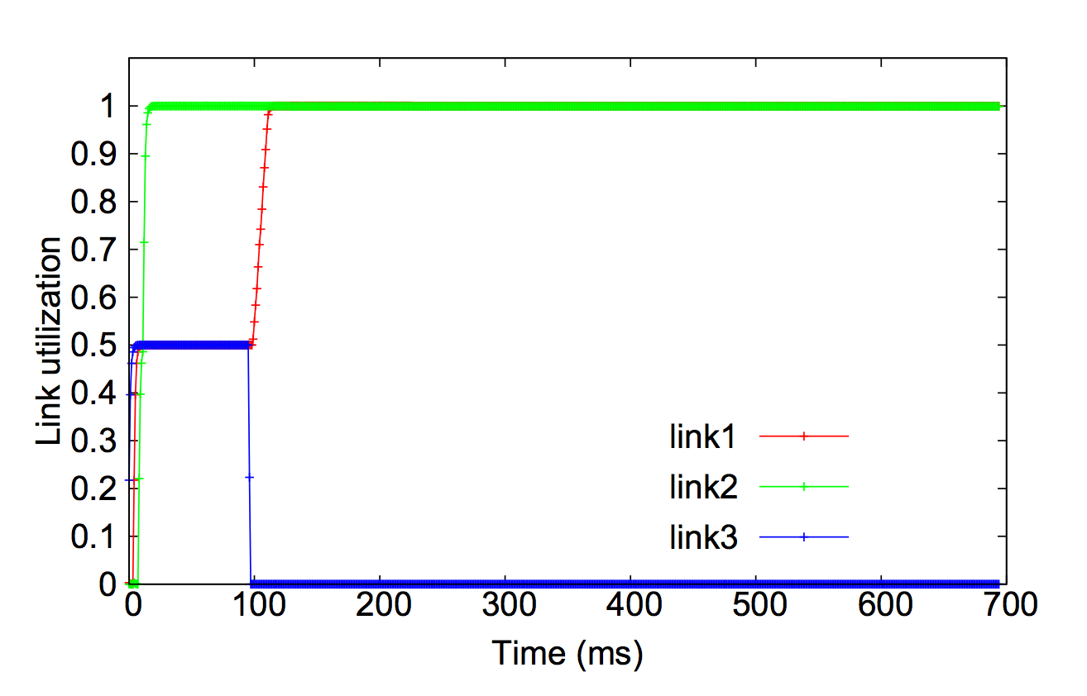
HULA is stable on link failure

Slide 32
HULA - Summary
Scalable to large topologies
HULA distributes congestion state
Adaptive to network congestion
Proactive path probing
Reliable when failures occur
Programmable in P4!
Notes:
This leads to a design that is topology oblivious (it makes no assumptions about symmetry or number of hops in the network)
The distribution of only the relevant utilization state to network switches mitigates concentration of a huge amount of state at the sender.
Since each switch makes the routing decision based on the INT info, there is no separate source routing mechanism necessary.
And most interesting thing is that all this logic is programmable in P4. I can discuss the details offline if you are interested.

Slide 33
Backup
Notes:
Ok, let’s see why correctness is tricky compared to say traditional IP rule caching.

Slide 34
HULA: Scalable, Adaptable, Programmable
LB Scheme | Congestion aware | Application agnostic | Dataplane timescale | Scalable | Programmable dataplanes
ECMP
SWAN, B4
MPTCP
CONGA
HULA

